Slide 1
What is Climate?
The record of weather patterns over a long period of time for an area/region.

Slide 2
The record of weather patterns over a long period of time for an area/region is called its…….?
Climate

Slide 3
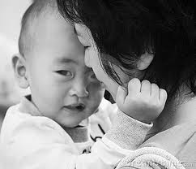
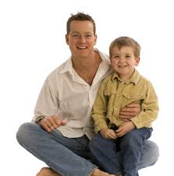
The ………. Is the main source of energy for weather and climate.
Sun

Slide 4
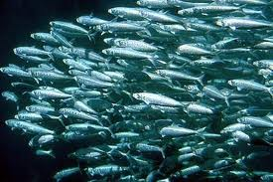
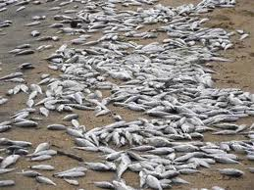
How does the El Nino Southern Oscillation affect fishermen?
=
=
Warm waters from the west flows over the usual pattern and temperatures increase and the fish population decreases.

Slide 5
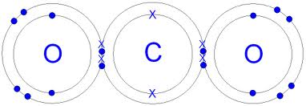
Which gas contributes most to global warming?
Carbon Dioxide

Slide 6
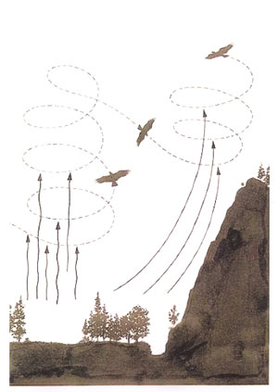
What is a thermal?
A small heat driven air current
(Thermal means heat)

Slide 7
How is a low pressure system formed?
Rising warm air.

Slide 8
How is a high pressure system formed?
Sinking cold air.

Slide 9
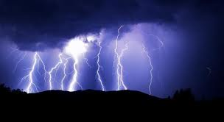
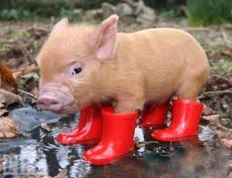
What type of weather is associated with low a pressure system?
Wet, stormy weather

Slide 10
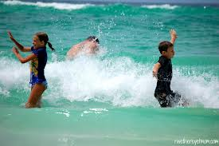
What type of weather is associated with high a pressure system?
Clear & Calm weather

Slide 11
How are tornadoes and hurricanes similar?
They’re systems of rotating air, (winds), around low pressure.

Slide 12
How are tornadoes and hurricanes different?
Tornadoes – wind speed is higher.
Hurricanes – system is bigger.

Slide 13
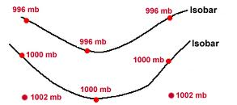
What information is shown on a meteorologist’s weather map?
Isobars

Slide 14
What is the jet stream?
A High altitude, fast moving wind.

Slide 15
How does the jet stream affect weather?
It forms at sharp boundaries between warm and cold temps

Slide 16
What is a warm front?
The front edge of a warm air mass

Slide 17
What is a cold front?
The front edge of a cold air mass.

Slide 18
What type of weather is associated with a warm front?
Warm fronts are likely to be associated with large regions of light to moderate continuous rain.

Slide 19
What type of weather is associated with a cold front?
Cold fronts tend to be associated with the most violent weather among all types of fronts.

Slide 20
Which symbol is associated with a warm front?

Slide 21
Which symbol is associated with a cold front?

Slide 22
What scale is used to measure hurricanes?
……………………………………..

Slide 23
The Saffir-Simpson Hurricane scale measures……?
Wind speed, damage and storm surge.

Slide 24
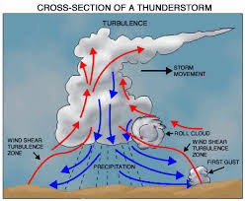
How are thunderstorms created?
Warm air rising in an updraft and cold falling in a downdraft create a convection current and storm system.

Slide 25
What drives thermohaline currents?
Differences in temperature and salinity, (saltiness)

Slide 26
What is another name for thermohaline currents?
Deep ocean currents.

Slide 27
Why are oceans are high in salinity?
*Rivers carrying dissolved minerals.
*Gases released by volcanoes.
*Minerals on the ocean floor.

Slide 28
What factors affect the density of seawater?
Salinity
Temperature
Evaporation

Slide 29
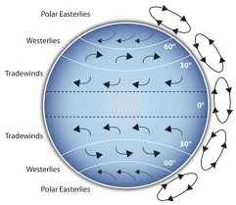
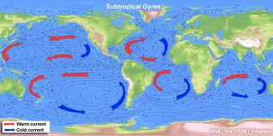
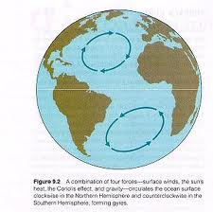
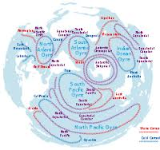
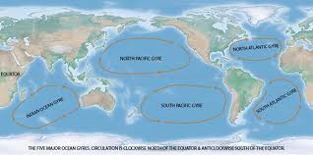
What drives gyres?
The coriolis effect and the shape of the coastlines.

Slide 30
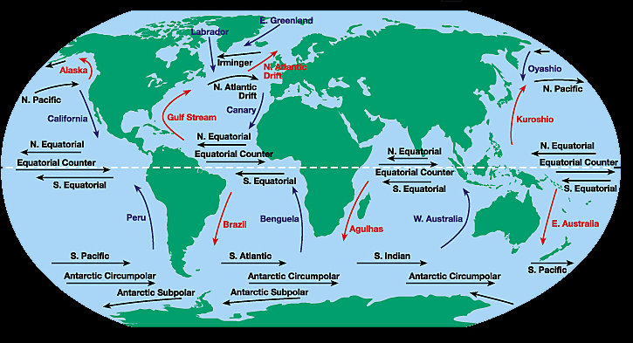
In what directions do gyres flow in the Northern hemisphere?
Clockwise

Slide 31
In what directions do gyres flow in the Southern hemisphere?
Counter clockwise

Slide 32
Why are ocean currents are important to the earth?
* Helps control earth’s temps.
* Spread heat throughout the earth.
* Phytoplankton in oceans provide most of earth’s oxygen.
* Important source of water for the water cycle.

Slide 33
Resources that can be replaced naturally in a relatively short period of time (a human’s lifetime) are called…?
Renewable

Slide 34
Resources that can NOT be replaced naturally in a relatively short period of time are called…?
Non-Renewable

Slide 35
What are some examples of earth’s energy resources?
Sun MovingWater Wind

Slide 36
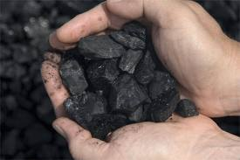
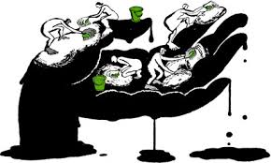
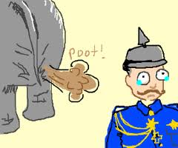
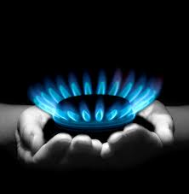
What are some examples of fossil fuels?
Coal Oil/Petroleum Natural
Gas

Slide 37
What is a solar cell?
It’s used to convert solar energy into electricity.

Slide 38
What is a cars main source of energy?
Petroleum/Gas

Slide 39
The burning of wood or agricultural waste is an example of what renewable resource?

Slide 40
What energy resource is used most in electrical production?
Coal

Slide 41
What element is used to fuel nuclear power plants?
Uranium

Slide 42
What percent of the United States electricity production comes from nuclear power?
Approximately 20%

Slide 43
Which resource has the highest cost value when used?
Nuclear

Slide 44
What resource has the least chance of being used 50 years from now.
Oil/Petroleum

Slide 45
How is Hydroelectric power produced?
Falling water turns turbines to power generators that produce electricity.

Slide 46
What are some advantages to using nuclear fuel?
Does not create air pollution.

Slide 47
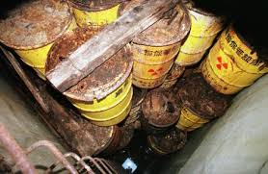
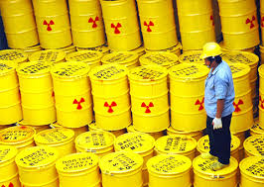
What are some disadvantages to using nuclear fuel?
It’s expensive, and hard to dispose of radioactive waste.

Slide 48
Why is it a good idea to recycle?
Saves space of landfills.

Slide 49
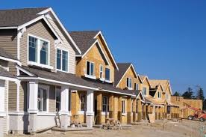
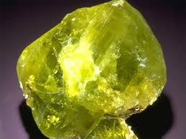
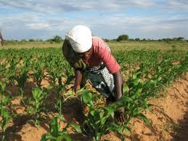
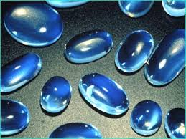
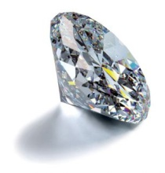
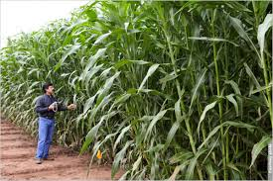
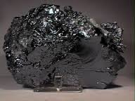
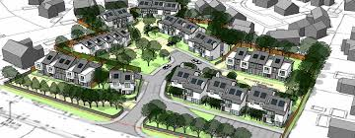
Why is land a valuable non-renewable resource?
Growing crops, development of housing, stores………..Earth’s crust loaded with minerals.

Slide 50
Name the wind Patterns, (top to Bottom)
Easterlies
Westerlies
Horse Latitudes
N.E. Trade winds
Equatorial Doldrums
S.E. Trade winds
Horse Latitudes
Westerlies
Easterlies

